Slide 1
Measurements
Science Lesson
Physics

Slide 2

Goals & objectives
7TWSc.02 Decide what equipment is required to carry out an investigation or experiment and use it appropriately.
7TWSc.03 Evaluate whether measurements and observations have been repeated sufficiently to be reliable.
7TWSc.04 Take appropriately accurate and precise measurements, explaining why accuracy and precision are important.

Slide 3
Agenda
01
03
02
04
How to be accurate in your measurements
Heat and Temperature
Scientific methods
Precision

Slide 4
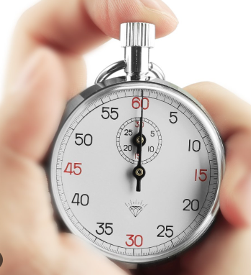
Accuracy
01
It depends on your measuring instrument.
How well it has been made and calibrated.
How well the scale has been constructed.
Example:
The stop watch that measures by seconds cannot
be used in measuring the tenth of second.

Slide 5
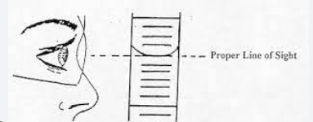
Accuracy
It depends on your measuring instrument.
3. How well you use the instrument.
Example:
Placing both ends of a ruler is important.
Resetting the stopwatch before repeating the timing.
Balance must be set on zero before any masses is put on it.
Balance must be put on a stable place.
Balance with a scale must be measured at the position of the pointer.
Graduated cylinder must be seen with the eyes in the same level
with the level of the liquid.

Slide 6
Precision
02
When you take a measurement, you should
take it a few times to check that they stay the same.
If it does, so now they are precise and reliable.
If it does not, may be you can identify anomalous
Result and this mostly occur in the early part
of your investigation.

Slide 7
Precision
02
To improve your experiment, repeat the test and take the average of
the results to have more reliable and precise results.
Remember:
Average = The sum of your results.
Their numbers

Slide 8
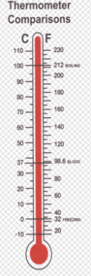
Heat and Temperature
03
The most widely used temperature scale is Celsius scale, it has two fixed points :
0 ºC – The Melting point of ice and also the freezing point of water.
100 ºC – The boiling point of water.
Temperature scale is divided into 100 ºC.
Temperature scale must have two fixed points as temperature compares the degree of hotness or coldness of substance relative to the fixed points.

Slide 9
Scientific Method
04
Ask a question.
Research answers.
Develop a hypothesis
Design and conduct experiments
Collect and analyze data and record
the data

Slide 10
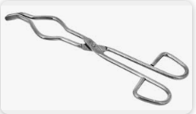
Scientific Method
Lab Safety
Wear safety goggles.
Wear lab coat.
Wear gloves if necessary.
Don’t eat at your work station.
Clean up your workspace.
Working with keeping distance away from the table.
Hold hot objects using gloves and tongs.

Slide 11
Scientific Method
Variables
Controlled Variables: keeping certain variables the same in an experiment to make a fair test.
Independent Variables (variable to change): variables that are changed by the scientists to investigate their effect.
Dependent Variables (variable to measure): the variables that are measured and are influenced or dependent on the changes made to the independent variable in an experiment.

Slide 12
Scientific Method
Prediction
Suggesting what will happen:
I guess…………….
I think………………………..

Slide 13
Scientific Method
Collecting results
When you start measuring variables.
Example:
The reading is ………………..

Slide 14
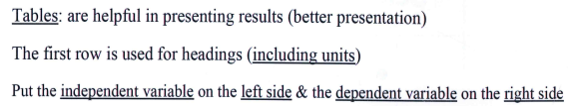
Scientific Method
Recording Data in Tables .
Independent variable | Dependent variable

Slide 15
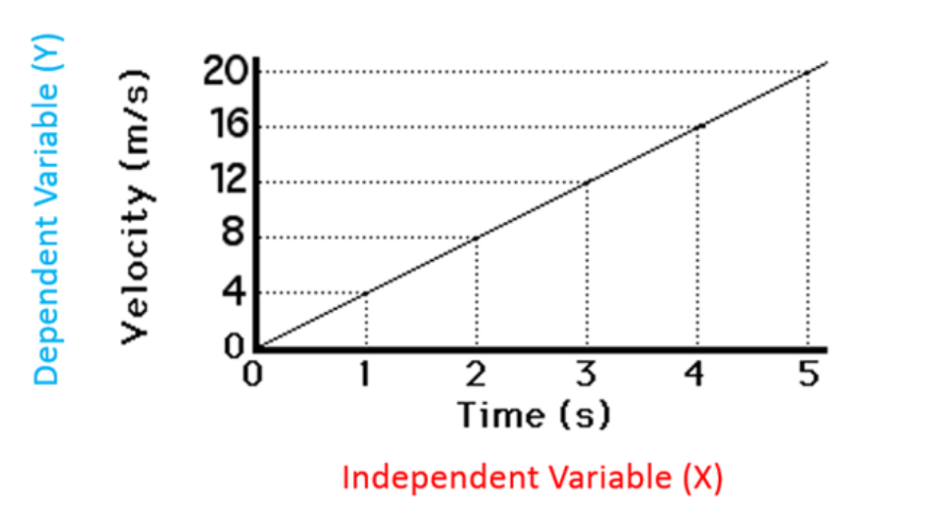
Scientific Method
Graphs: They help in showing trends and anomalous results

Slide 16
Scientific Method
Conclusion and Reflection
Shows the relation between the dependent and
independent variables
Example:
The greater the --------------, the more the ------------------------.

Slide 17
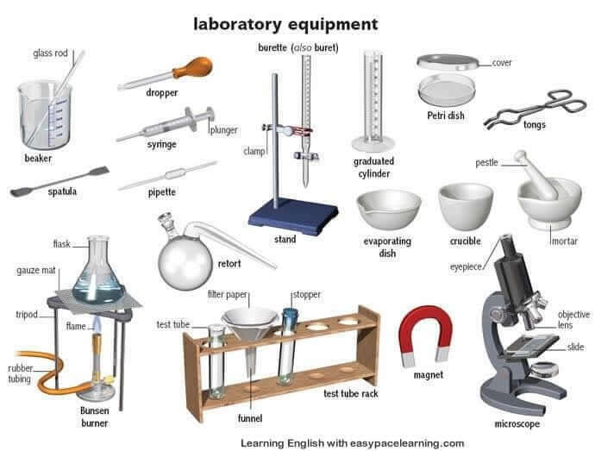
Scientific Method
Different lab equipment.

Slide 18

Study well

